Slide 1
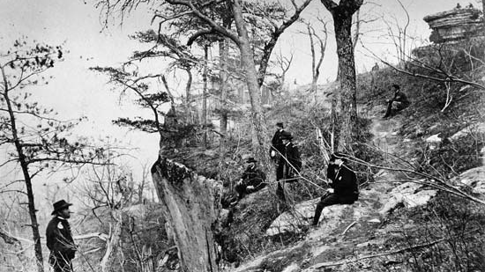
General Grant’s Lookout Point, Chattanooga, TN

Slide 2
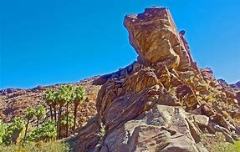
The Rock that is Higher than Us! Psalm 61
Sacred Selections #126
Immersion into Christ without continued faithfulness in His service will not save us!
1 Corinthians 10:12
Hebrews 6: 1- 6
We must seek God’s continued protection of us, for we are always in need of Him!
Hebrews 13: 5 – 6
Hebrews 11:6

Slide 3
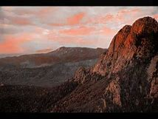
David Requested Divine Help
“Hear my cry, O God; attend unto my prayer. From the end of the earth will I cry unto thee, when my heart is overwhelmed: lead me to the rock that is higher than I.”
“The end of the earth…”
Psalm 42
We Must Seek God!
Acts 17: 23 – 29
1 Peter 1: 1 - 12

Slide 4
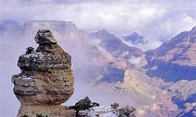
This ROCK is Christ!
Deut. 32: 1 – 4; 15
1 Corinthians 10: 1- 4

Slide 5
David Appreciated the Former Mercies of God
For thou hast been a shelter for me, and a strong tower from the enemy. I will abide in thy tabernacle for ever: I will trust in the covert [PROTECTION] of thy wings. Selah.
Colossians 1: 3 – 14
Christians are protected
2 Cor. 6: 14- 18
1 Pet. 2: 1- 10

Slide 6
Such Elevation Grants Us Confidence -- Our Prayers are Heard!
For thou, O God, hast heard my vows: thou hast given me the heritage of those that fear thy name.
1 Peter 3: 10 – 12
Hebrews 12: 1- 2

Slide 7
Eternal Blessings to the King!
Thou wilt prolong the king's life: and his years as many generations. He shall abide before God for ever: O prepare mercy and truth, which may preserve him.
Hebrews 13:8
John 1:17

Slide 8
Thus, there is assured deliverance when we remain in the Rock that is higher than us!
So will I sing praise unto thy name for ever, that I may daily perform my vows.
Revelation 2:10; 14:13
1 John 5: 13 – 21

